Slide 1
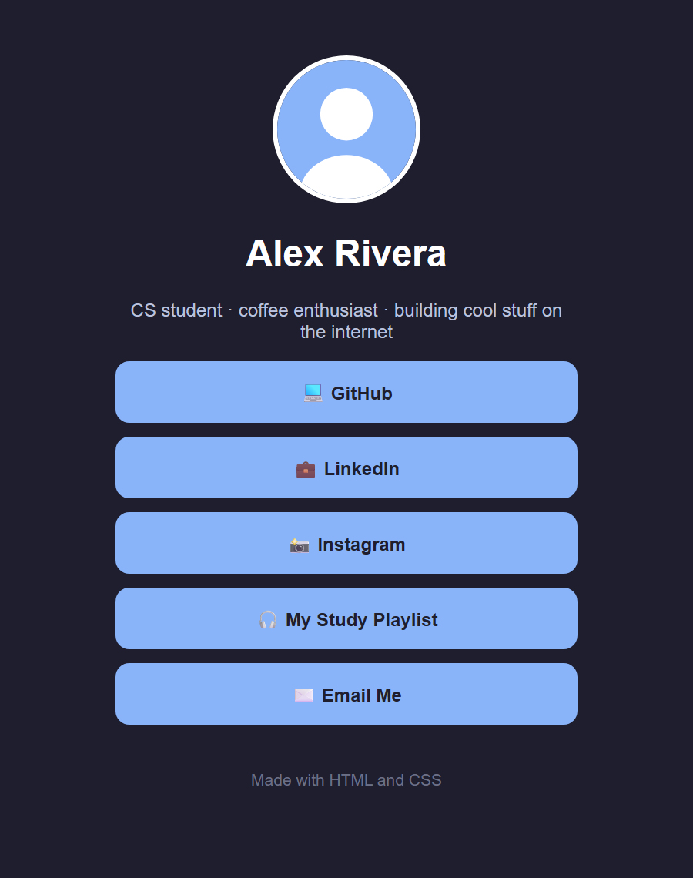
Build Your Own Linktree
CS CLUB WORKSHOP
Make a personal link page with HTML and CSS. No experience needed.
Notes:
Show your live published version of linktree-finished. Hover the buttons, click a link. "By the end of today you'll have one of these, and you'll have built it yourself."

Slide 2



Today you'll build this, from scratch
TODAY
HTML
Put your name, bio, photo, and links on a page
CSS
Turn it into a styled page with clickable buttons
Publish (optional)
Put it online with a real URL for your bio
Notes:
Quick overview of the three parts. Point at the phone screenshot: this is what everyone will have by the end.

Slide 3
The plan for today
THE PLAN
1
2
3
4
5
Setup
HTML
CSS
Make it yours
Put it online
Get the files open
Add your content
Make it look good
Challenges and free time
Optional: get a real URL
Ask questions anytime. Helpers are walking around, so raise your hand if you get stuck.
Notes:
Introduce helpers by name.

Slide 4



Every website is built from 3 languages
THE BIG IDEA
Not today!
HTML
CSS
JavaScript
The structure
The style
The behavior
Like the walls and rooms of a house. It says what is on the page.
Like the paint and decoration. It says how things look.
Like the electricity. It makes things do stuff.
Notes:
House analogy. Then the magic trick: in linktree-finished, delete the <link rel="stylesheet"> line, save, refresh (ugly). Undo, save, refresh (pretty). "Same HTML. The only difference is CSS."

Slide 5
Setup
01
Get the starter files open in your editor and your browser
Notes:
About 10 minutes. Put the download link and QR code on screen.

Slide 6

Download and unzip the starter files
SETUP
1
Download
Get linktree-starter.zip from the link
2
Unzip it
Windows: right-click → Extract All · Mac: double-click
3
Put it somewhere easy
Paste your download link and QR code here
Move the folder to your Desktop
Watch out (Windows)
Double-clicking a zip only lets you peek inside. Edits won't save. Always Extract All first.
Notes:
The #1 setup problem: editing files inside the zip on Windows. Walk around and check.

Slide 7


Open it in VS Code and in your browser
SETUP
Open the folder in VS Code
Open the page in your browser
File → Open Folder
Pick linktree-starter
"Trust the authors?" → Yes
Click index.html on the left
Find index.html in your folder
Double-click it (or drag it into the browser)
The address bar starts with file:///, so only you can see it for now
No VS Code? Windows: Notepad works. Mac: TextEdit, but click Format → Make Plain Text first.
Notes:
Address bar: "This page lives on YOUR computer. We'll put it online at the end."

Slide 8



The golden loop
SETUP
Edit
Save
Refresh
Change your code
Ctrl + S / Cmd + S
F5 / Cmd + R
repeat
Forgot to save or forgot to refresh? That's almost every "it's not working!" today. A white dot on the VS Code tab means the file isn't saved.
Notes:
Write Edit → Save → Refresh on the board and leave it there. Optional: File → Auto Save in VS Code.

Slide 9

Thumbs up when you see your page
Looks plain? That's normal, we haven't styled it yet. Stuck? Raise your hand.
Notes:
Wait until most of the room is ready. Helpers handle the rest.

Slide 10
HTML: the content
02
Put your name, bio, photo, and links on the page
Notes:
About 20 minutes. Steps 1 to 3.

Slide 11
Anatomy of a tag
HTML
index.html
<h1>Your Name</h1>
opening tag
content
what you see
closing tag
notice the /
Tags are like labels on boxes. This one says "this box is a heading."
Gray text like <!-- note --> is a comment: a note for humans that the browser ignores.
Notes:
Opening tag, closing tag (with the slash), content in between.

Slide 12
The 4 tags we'll use today
HTML
<h1>
<p>
<a>
<img>
heading 1
paragraph
anchor
image
The biggest heading. Your name goes here.
A block of text. Your bio goes here.
A link to another page.
A picture, like your profile photo.
<head> = info about the page. It's boilerplate that almost every site has.
<body> = everything you can see. This is where we'll work.
Notes:
Scroll through index.html top to bottom. Point out comments, head vs body, and the ✏️ markers.

Slide 13
Change your name and bio
HTML · STEP 1
index.html
<title>Your Name | Links</title>
<h1>Your Name</h1>
<p class="bio">A short sentence about who you are.</p>
DO THIS
Watch out
Change Your Name in the <h1> to your name
Write a short bio in the <p>
Change the <title> too (it's the text on the browser tab)
Save → Refresh
Only change the text between the tags
Keep every <, >, and /
Notes:
The <title> is in the <head>; the <h1> and <p> are in the <body>. After refreshing, point out the browser tab changed too.

Slide 14
Add your links
HTML · STEP 2
index.html
<nav class="links">
<a class="link" href="https://github.com">💻 GitHub</a>
<a class="link" href="https://linkedin.com">💼 LinkedIn</a>
<a class="link" href="https://instagram.com">📸 Instagram</a>
<a class="link" href="mailto:you@example.com">✉️ Email Me</a>
</nav>
DO THIS
Watch out
href = where the link goes
The text between the tags = what people see
To add a link, copy a whole line and change it
URLs must start with https://
Whole page turned into a link? A </a> is missing
Notes:
class="link" is a name tag we'll use with CSS later. The highlighted line is an added email link (mailto:). Emoji keyboard: Win + . (Windows) / Ctrl + Cmd + Space (Mac).

Slide 15
Add your profile picture
HTML · STEP 3
index.html
<img class="avatar" src="profile.svg" alt="Profile picture">
<!-- change src to your photo's exact file name -->
<img class="avatar" src="me.jpg" alt="Photo of me">
DO THIS
Watch out
Copy your photo into the linktree-starter folder
Change src to its exact file name
Save → Refresh
Me.JPG ≠ me.jpg: names must match exactly
Windows hides extensions: View → Show → File name extensions
iPhone .HEIC photos won't show. Use JPG or PNG.
<img> has no closing tag. alt describes the picture.
Notes:
No photo? Keep profile.svg, or paste any image URL into src. alt is read aloud by screen readers. If the picture is enormous: "Perfect, that's CSS's job, coming up next."

Slide 16

HTML done!
Everything on your page is now your content. Is your picture enormous? Good, CSS fixes that next.
Notes:
Quick check that everyone has their name, links, and photo in.

Slide 17
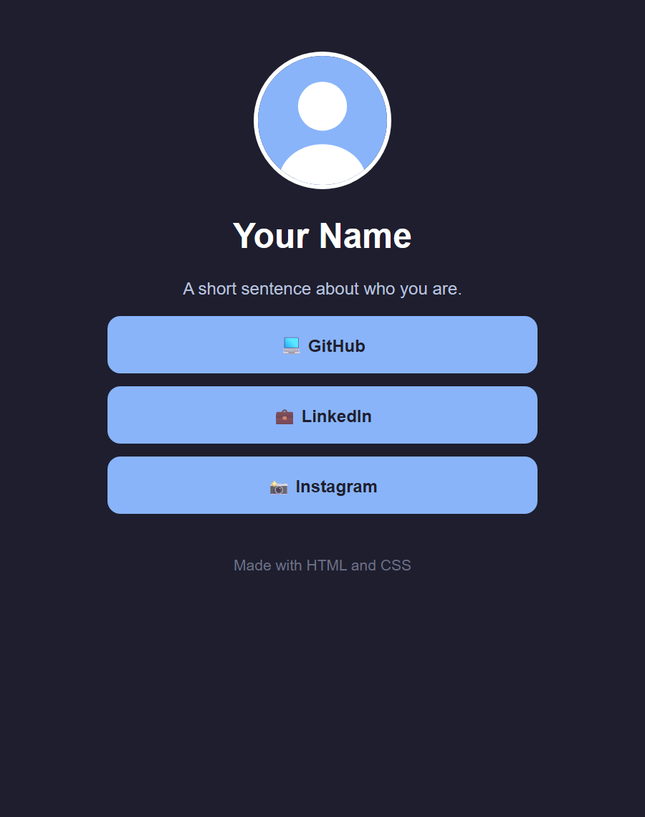
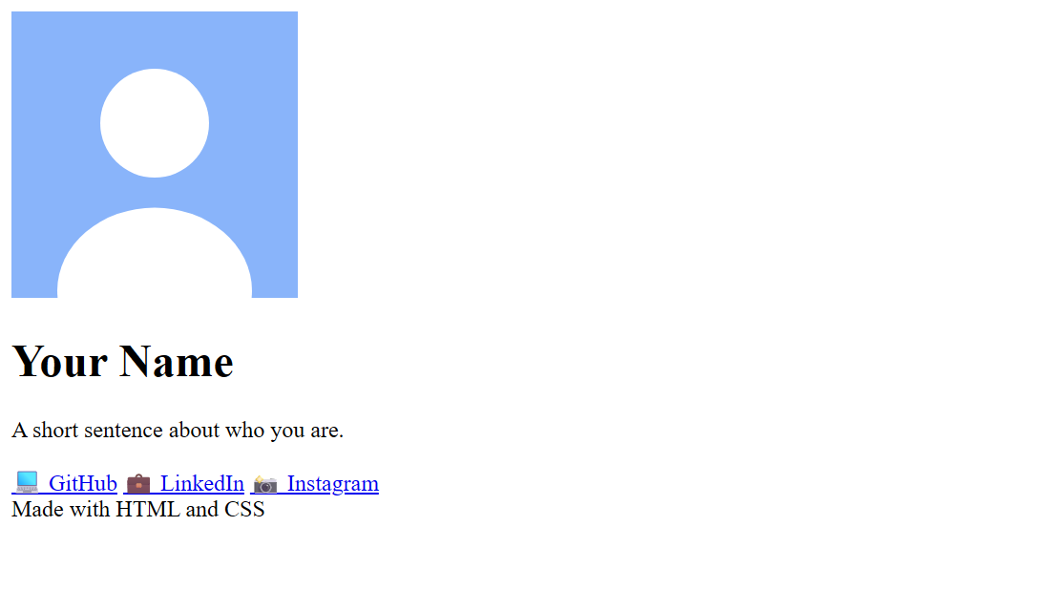
CSS: the style
03
before
Turn a plain page into a real link page
after
Notes:
About 20 minutes. Steps 4 to 9. Switch to style.css.

Slide 18
Anatomy of a CSS rule
CSS
style.css
selector
who gets styled
body {
background-color: black;
}
property
what to change
value
what to change it to
{ }
Curly braces wrap the rule
:
A colon goes after the property
;
A semicolon ends every line
Notes:
Selector = who, property = what, value = to what. The colors on the chips match the colors in the code.

Slide 19
Classes are name tags
CSS
index.html
class="link" puts a name tag on an HTML element
.link in CSS styles everything wearing that name tag
The dot means "class." No dot, like body, means every tag of that kind.
<a class="link" href="...">💻 GitHub</a>
style.css
.link {
color: white;
}
Notes:
Remember the class="link" name tags from the HTML? .link means everything wearing that name tag.

Slide 20
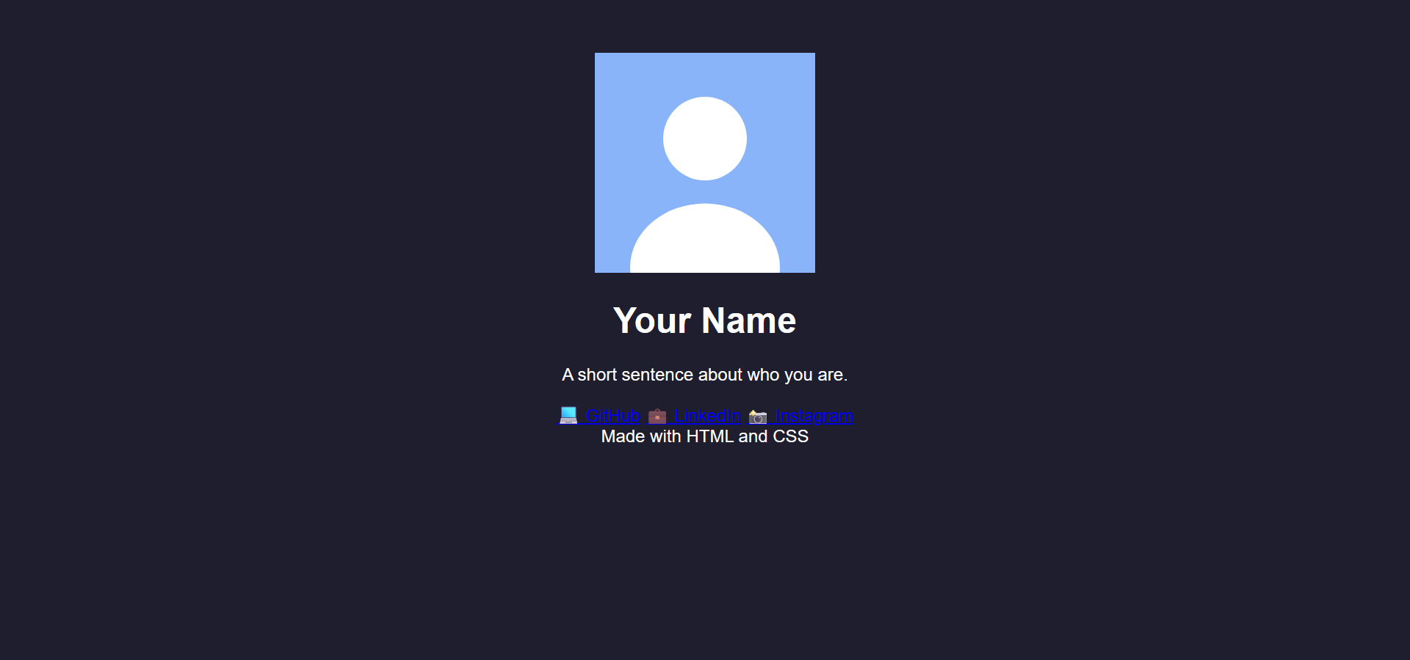
Style the whole page
CSS · STEP 4
style.css
YOU SHOULD SEE
body {
background-color: #1e1e2e;
color: white;
font-family: Arial, sans-serif;
text-align: center;
padding: 40px 20px;
}
#1e1e2e is a hex color. Names like hotpink work too.
color = the text color
padding = space around the edge of the page
Try it: change the background to hotpink
Notes:
Show the VS Code color square: hover or click it for a color picker. padding: 40px 20px = 40 top and bottom, 20 left and right.

Slide 21
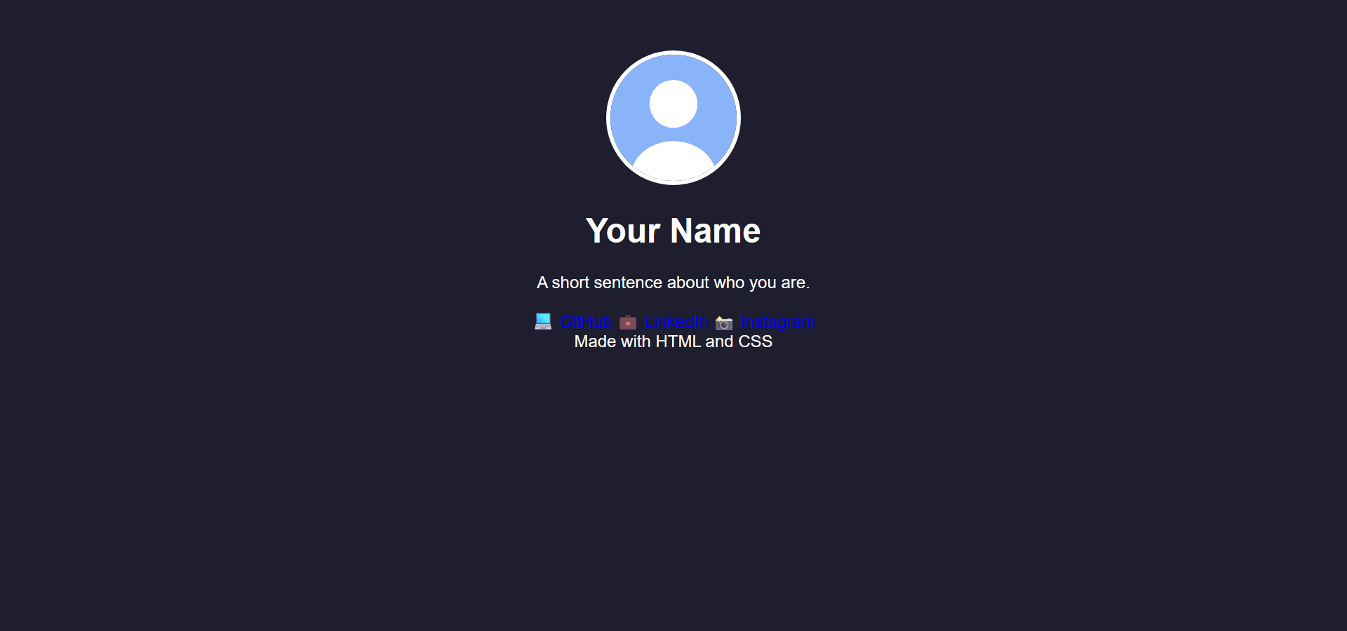
Make the profile picture round
CSS · STEP 5
style.css
YOU SHOULD SEE
.avatar {
width: 120px;
height: 120px;
border-radius: 50%;
object-fit: cover;
border: 4px solid white;
}
px = pixels, the tiny dots on your screen
border-radius: 50% → a circle
object-fit: cover → crop, don't squish
Try it: border-radius: 20px;
Notes:
border is written as thickness, style, color. Try dashed instead of solid.

Slide 22
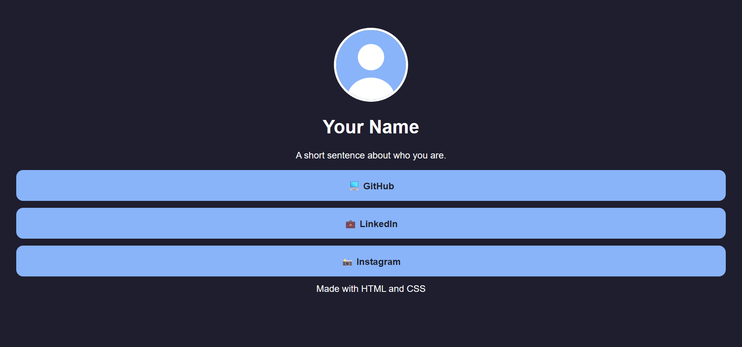
Turn the links into buttons
CSS · STEP 6
style.css
YOU SHOULD SEE
.link {
display: block;
background-color: #89b4fa;
color: #1e1e2e;
padding: 16px;
margin-bottom: 12px;
border-radius: 12px;
text-decoration: none;
font-weight: bold;
}
display: block → each link gets its own row
text-decoration: none → no underline
Uh oh: way too wide on a laptop. Fixing that is next.
Notes:
Links are inline by default (side by side like words). block makes each one a full row, like a brick. Next slide explains padding vs margin.

Slide 23
Padding vs. margin
CSS
MARGIN: space outside
Padding
Bubble wrap inside the box. It makes the button bigger.
PADDING: space inside
padding: 16px;
GitHub
Margin
Personal space outside the box. It pushes other things away.
margin-bottom: 12px;
Notes:
Draw this on the board too. Padding = bubble wrap inside the box. Margin = personal space outside it.

Slide 24
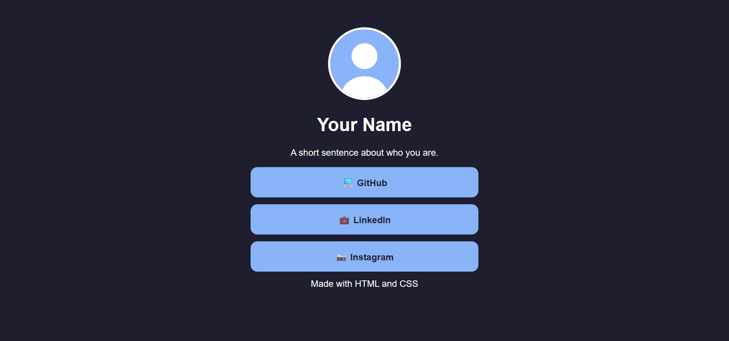
Stop everything from getting too wide
CSS · STEP 7
style.css
YOU SHOULD SEE
.card {
max-width: 400px;
margin: 0 auto;
}
max-width → never wider than 400px (it can still shrink on phones)
margin: 0 auto → split the leftover space evenly, which centers it
Try it: drag your browser window narrower and wider
Notes:
0 on top and bottom, auto on left and right.

Slide 25
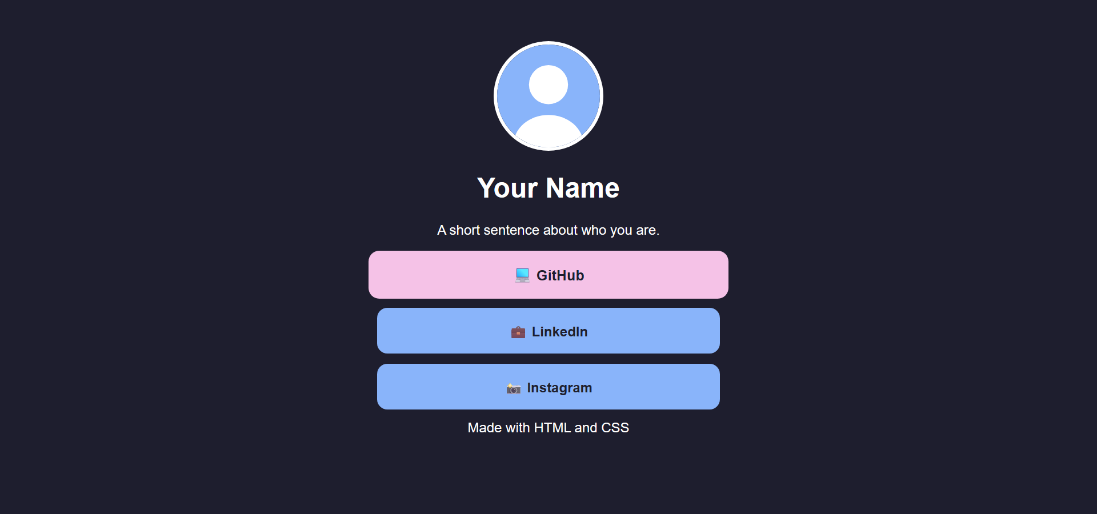
Add a hover effect
CSS · STEP 8
style.css
YOU SHOULD SEE
.link:hover {
background-color: #f5c2e7;
transform: scale(1.05);
}
/* then go back UP to .link { }
and add this line inside it: */
transition: 0.2s;
:hover → only while the mouse is over it
scale(1.05) → grow to 105%
transition → animate the change smoothly
Notes:
Hover a few times BEFORE adding transition (it's instant and choppy). Then add transition to .link, save, refresh: smooth. Good moment to show you can add to an existing rule.

Slide 26
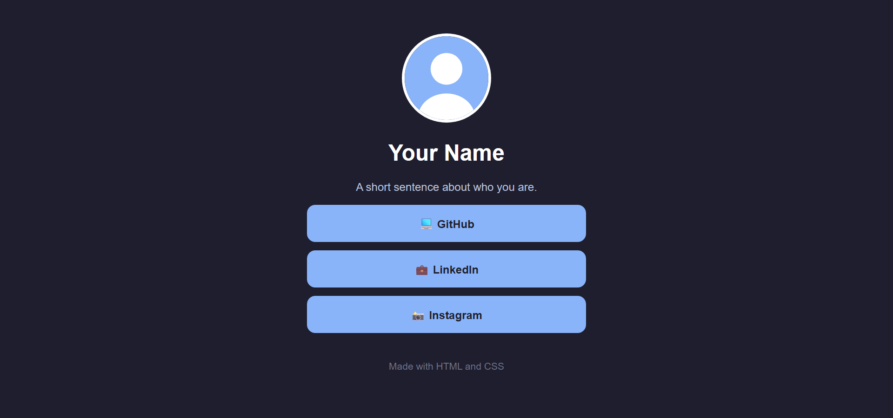
Finishing touches
CSS · STEP 9
style.css
YOU SHOULD SEE
.bio {
color: #bac2de;
}
footer {
margin-top: 40px;
font-size: 14px;
color: #6c7086;
}
A softer bio color and a quieter footer
Small details like these make a design look polished
Compare yours with this screenshot
Notes:
Anyone behind can copy style.css from linktree-finished.

Slide 27

You just built a website!
Behind? Copy style.css from linktree-finished and keep going.
Notes:
Celebrate. Then the DevTools demo.

Slide 28
Pro tip: experiment live with DevTools
BONUS
1
Right-click your page → Inspect
2
Click an element, then change its CSS in the Styles panel
3
Ctrl + Shift + M (Cmd + Shift + M on Mac) → phone view
4
Changes disappear on refresh. Copy what you like into style.css.
Notes:
Most people open a linktree on their phone. Ours already works there thanks to max-width.

Slide 29
Make it yours
04
Change colors, fonts, anything. Here are some ideas.
Notes:
Free time. You and the helpers walk around.

Slide 30
Pick a challenge
MAKE IT YOURS
Easy
Medium
Hard
Your own color palette
Gradient background
Outline-style buttons
Generate one at coolors.co
linear-gradient
Transparent + border, fill on hover
A different font
Open links in a new tab
Group your links
Try Georgia or Courier New
target="_blank"
Add <h2> section headings
Button shadows
A Google Font
Real brand icons
Look up box-shadow
fonts.google.com
Font Awesome or Simple Icons
Code for all of these is on your cheat sheet.
Notes:
Leave this up during free time. Snippets are in the Member Cheat Sheet and the presenter notes.

Slide 31
Put it online
05
Optional: get a real URL you can put in your bio
Notes:
About 15 minutes, or make it homework.

Slide 32

Publish with GitHub Pages
PUT IT ONLINE
1
github.com → + → New repository
It will be public
2
Name it exactly YOUR-USERNAME.github.io → Public → Create
No phone numbers, home addresses, or anything you wouldn't put on a poster
3
Click uploading an existing file
Drag in your files (not the folder) → Commit changes
YOUR-USERNAME.github.io
4
5
Settings → Pages: Deploy from a branch → main → / (root) → Save
Your live URL. Put it in your Instagram, TikTok, or LinkedIn bio!
6
Wait 1 to 2 minutes, then visit your URL
File must be named index.html. Updates take a minute or two to show up.
Notes:
Alternative: app.netlify.com/drop (drag the folder in; free account needed to keep it). To update later: click a file in the repo → pencil icon, or Add file → Upload files.

Slide 33
Stuck? Check these first
STUCK?
Nothing changes
No styling at all
CSS stops working partway
Did you save? Refresh? Unzip the folder first?
style.css must be in the same folder as index.html
Look for a missing }, :, or ; just above it
Broken image icon
Link gives an error
Everything became a link
File name must match exactly. Same folder? No .HEIC.
URLs need https:// at the start
You're missing a closing </a>
Notes:
Good slide to leave up during free time.

Slide 34



Share your link!
YOU DID IT
KEEP LEARNING
MDN Web Docs
developer.mozilla.org
freeCodeCamp
freecodecamp.org
Post your URL in the club chat. Next time: JavaScript, to make things do stuff.
Flexbox Froggy
flexboxfroggy.com
Notes:
Show and tell: ask 2 or 3 volunteers to share their page (ask first). Quick feedback poll: what was the most confusing part?

